Slide 1
By Ulf Sandberg
Swedish National Road and Transport Research Institute (VTI), Linköping, Sweden
Presentation at LEO International Seminar
Oslo, Norway, 2 June 2016

Slide 2
ROSANNE =
ROlling resistance, Skid resistance, ANd Noise Emission measurement standards for road surfaces

Slide 3
ROSANNE project
FP7 Small Collaborative Research Project
Coordinator: AIT (Austria)
Partners: DRD (Denmark) BRRC (Belgium)
TRL (UK) TUG (Poland)
VTI (Sweden) ZAG (Slovenia)
BASt (Germany) FEHRL (Belgium)
IFSTTAR (France) DIN (Germany)
Third parties: CEREMA (France)
Budget: 3.0 million €
Duration: 3 years (1 November 2013 - 31 October 2016)
Notes:
Negotiation Phase
FP7 Coordinated Action:
Coordinated Action: no research issues are possible; gathering and analysing existing knowledge, recommending future research issues, recommending coordinated approaches on certain issues, organising workshops, conferences, personnel exchange.
Consortium:
arsenal research (Austria), BASt (Germany), LCPC (France), RWS-DVS (The Netherlands), TRL (UK), ZAG (Slovenia), FEHRL (Belgium)
FEHRL: Forum of European Highway Research Laboratories; 29 Members (transport research institutes) of different European Countries; Formed task forces to work on certain important issues; not performing research on issues themselves but developing project ideas for pushing research issues forward;
Consortium: Participants of the FEHRL task force „skidding resistance“ + one partner from the NMS + FEHRL
Duration: 2 years
Approximately 1.1M EUR total
Expected starting date: 1st July 2008

Slide 4

Objectives
Advanced harmonization/standardization of
measurement methods for
  skid resistance
  noise emission
  rolling resistance
  of road pavements
Prenormative research creating the technical basis for draft standards
Close cooperation with CEN/TC 227/ WG 5 on road surface characteristics
and ISO/TC 43/SC 1/WG 27, 33, 39
Notes:
Setting up a platform and organising workshops/expert working groups (Milestones M1.1, M1.2, M2.1, M3.2, M4.1, M5.5)
- to network with past, current and future research activities on skid resistance, rolling resistance and noise emissions (Milestones M5.3, M5.4),
- to collect and share existing knowledge about these issues (Milestone M5.2) and
- to raise awareness concerning the safety relevance and greening influence of road surface parameters (Deliverables D5.1, D5.3).
Studying national standards/policies of different EU and neighbouring countries concerning skid resistance, rolling resistance and noise emissions, to document current practice in EU countries, to provide recommendations for a common European policy on skid resistance, rolling resistance and noise emissions. (Milestone M1.3)
Developing a road map/an implementation plan including specific stages for the short, medium and longer term (2010, 2015, 2020) towards the final harmonisation of skid resistance test methods and reference surfaces based on research work. (Milestone M2.5)
Creating one or more matrices showing interdependencies and environmental effects of the factors that influencing road surfaces and tyres in relation to skid resistance, rolling resistance and noise emissions. This matrix will allow knowledge gaps to be identified and indicate the need for future research work. (Milestone M3.1)

Slide 5
ROSANNE project and standardization
ROSANNE is a project on pre-normative research
  Creates the technical basis for standards
  Creates a draft document which can be used for standardization
  Presents status of this document to WG 5 at every meeting
  Delivers final draft document to WG 5
  Standardization process remains with CEN
Close cooperation with CEN and ISO standardization working groups covering the topics

Slide 6
The Technical Work Packages
Skid resistance (friction) – led by TRL
Noise – led by AIT
Rolling resistance – led by DRD
Common parameters (texture, ref tyres, ref surfaces, lateral variation) -- led by VTI
Implementation -- led by BASt

Slide 7
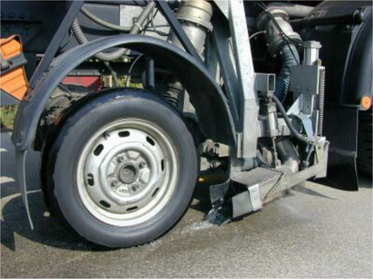
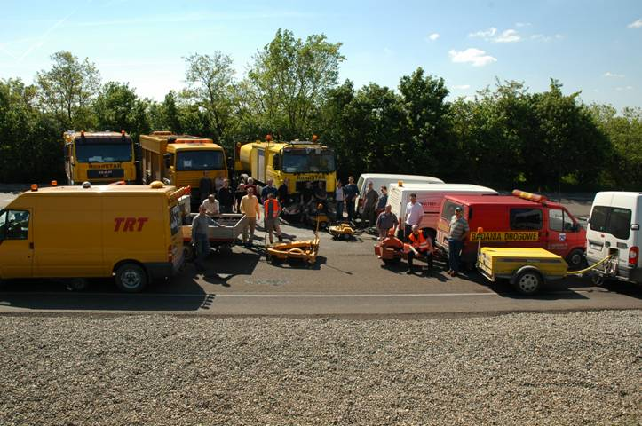
ROSANNE WP 1 – Skid resistance
Measurement methods for the skid resistance of road surfaces
Starting point
Skid resistance µ is key road surface parameter for road safety
More than 14 different skid resistance measurement devices across Europe
At least 2 physically different parameters measured (longitudinal, sideways friction)
Previous harmonization attempts yielded high uncertainties in conversion factors (standard deviation of σ_{R} =0,1 with µ typically in the range from 0 to1)
No comparability of results across Europe

Slide 8
ROSANNE – Skid resistance
Measurement methods for the skid resistance of road surfaces
Objectives
Harmonisation of skid resistance measurements in Europe
Using a common scale approach
Applicable to a significant number of the measurement devices currently used in Europe
Separation of devices following substantially different measurement principles
Achieving substantially reduced uncertainties when using the common scale

Slide 9
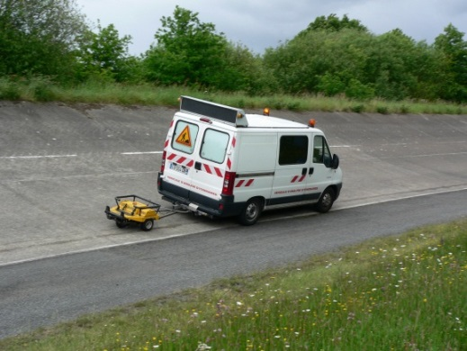
ROSANNE – Skid resistance
Measurement methods for the skid resistance of road surfaces
Activities
Analysis of previous projects
Separation of longitudinal and sideways friction devices into at least two groups
Increase of quality control for individual devices
Two rounds of comparison testing at IFSTTAR test tracks in Nantes, France
Derivation of conversion factors for the common scales
Assessment of remaining uncertainties
Preparation of the technical input for draft standards

Slide 10
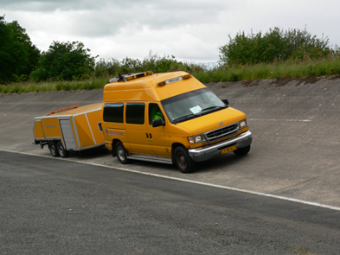
Skid resistance tests
First round of testing completed May 2014
    11 devices
      5 Side-force
      6 Longitudinal, fixed slip
Second round of testing completed April 2015
    18 devices
      8 Side-force
      10 Longitudinal, fixed slip
All devices from 1st trial also attended 2nd trial
  Enables stability of the common scale to be assessed

Slide 11
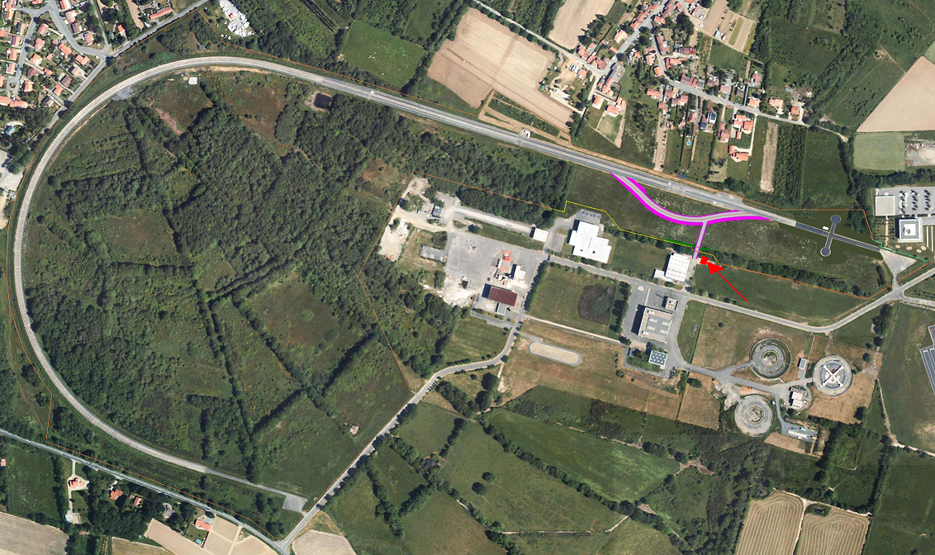
Skid resistance tests
Test speeds: All devices tested at 40, 60 & 80 km/h
12 surfaces with a range of skid resistance and texture
5 repetitions for each surface and speed
Test line of 50 cm
CHECK POINTS
END POINT
START POINT

Slide 12
Analysis
The devices were placed into 3 groups for the analysis
  Based on operating principle
  Represent different road user situations
Device group | Representative slip ratio
Side-force | 34 %
Longitudinal – low slip | 15-25 %
Longitudinal – high slip | over 60 %

Slide 13
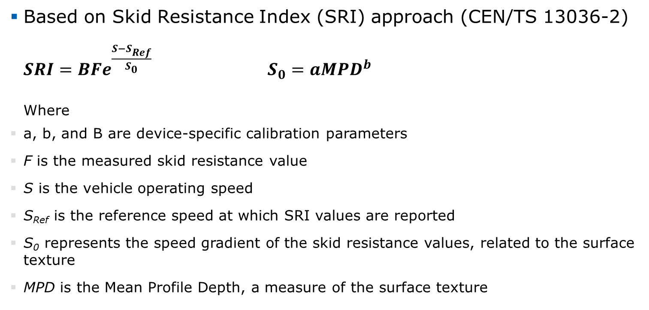
“Common scale”
Based on Skid Resistance Index (SRI) approach (CEN/TS 13036-2)
  $SRI=BFe^{\frac{S−S_{Ref}}{S_{0}}}$ $S_{0}=a{MPD}^{b}$
  Where
a, b, and B are device-specific calibration parameters
F is the measured skid resistance value
S is the vehicle operating speed
S_{Ref} is the reference speed at which SRI values are reported
S₀ represents the speed gradient of the skid resistance values, related to the surface texture
MPD is the Mean Profile Depth, a measure of the surface texture

Slide 14
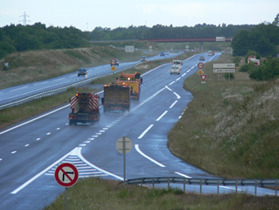
Results
Common scale developed for each device group
Device specific parameters calculated
Uncertainty of common scale values assessed by calculation of the reproducibility standard deviation, σ_{R}
  σ_{R} around 0.05
    compared to about 0.03 for fleets of the same device type
    compared to about 0.10 for previous harmonisation experiments
  Similar results from both trials
  Common Scale approach shows stability

Slide 15
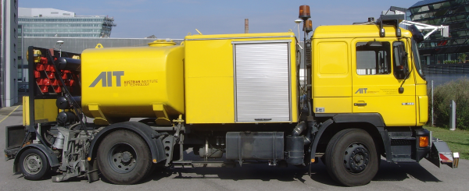
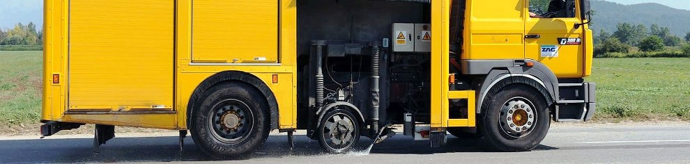
Conclusions
Measurements made by different devices can be converted to a common scale for each group
Assumptions made in developing the common scales have been proven correct
  Reproducibility is improved by developing common scales for different groups of devices based on their operating principle
  Uncertainty is at a level allowing cross-country comparisons
Robust QA procedures required

Slide 16
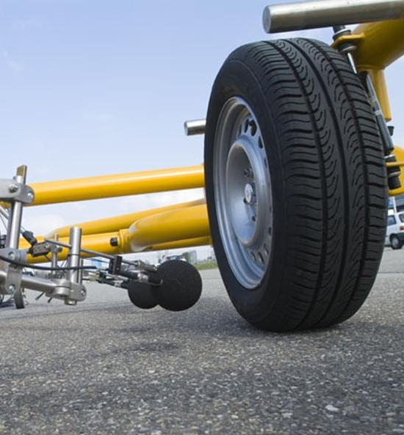
ROSANNE WP2 – Noise
Measurement methods for the noise emission properties of road surfaces
Starting point
Two existing ISO standards on measuring the influence of pavements on road traffic noise emission
Statistical Pass-By method (ISO 11819-1, SPB) records overall noise emission of passing vehicles, time consuming, measurement only at one spot per time
CPX method (ISO/DIS 11819-2, CPX) suitable for long-distance monitoring, but records only tyre/road noise, HGV noise by proxy tyre
Only meas. methods, full classification procedure missing
Link to new European traffic noise calculation method?

Slide 17
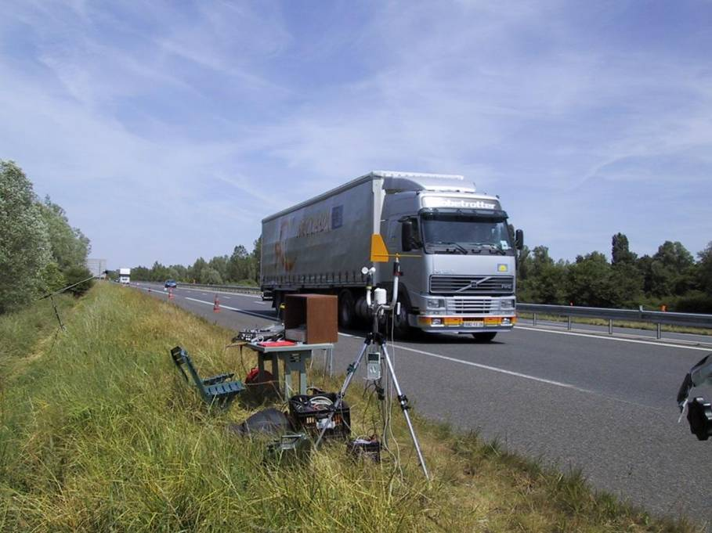
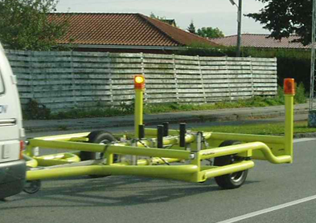
ROSANNE – Noise
Original objectives
Combine available measurement methods like SPB and CPX into one consistent and harmonized classification procedure
Facilitate comparison of road pavement noise emission data on the European level
Enable standardized measurement of noise emission data that can be included in European road traffic noise prediction methods

Slide 18
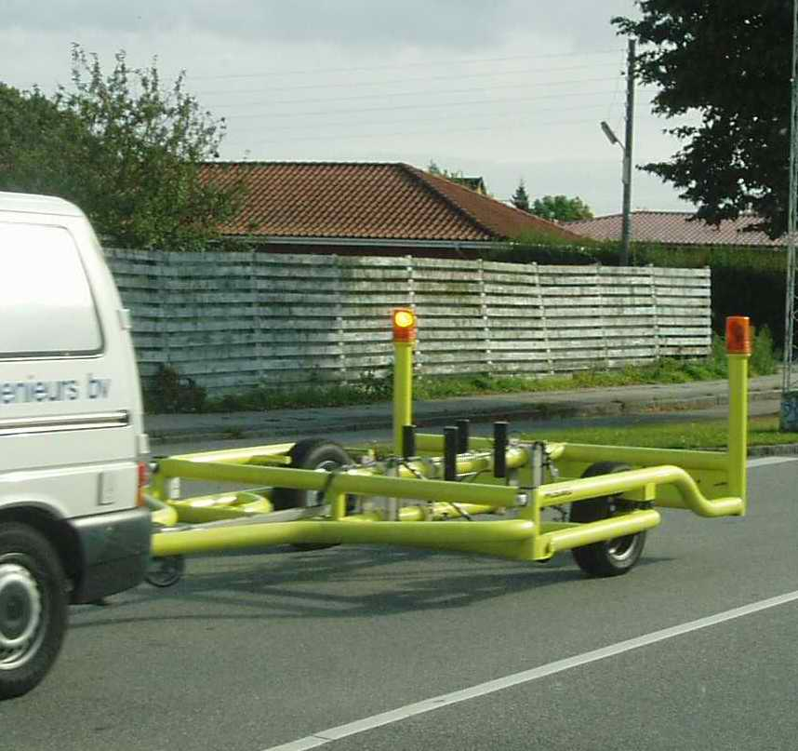
ROSANNE - Noise
Activities
Study of the relations between measurements of noise properties of road surfaces made with the available methods SPB (ISO 11819-1) and CPX (ISO/DIS 11819-2)
Development of a classification procedure for the influence of pavements of road traffic noise emission, suitable for standardization
Determination of temperature influence on tyre/road noise and corrections
Validation testing of actual road surfaces
Link to noise calculation method from the European Environmental Noise Directive

Slide 19
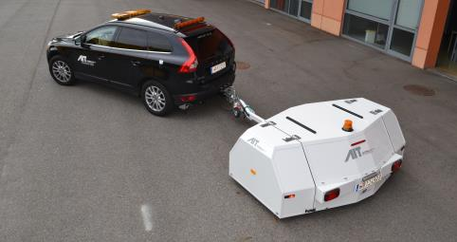
ROSANNE - Noise
Results:
Decision to focus on CPX as acoustic road surface characterization method, based on sufficiently accurate CPX-SPB correlations, and several other issues
Temperature corrections established in cooperation with ISO/TC 43/SC 1/WG 27, Draft Technical Specification will enter ISO procedures in summer 2016
Validation tests are being conducted in spring/summer 2016
Use in the context of the new EU road traffic noise prediction method envisaged

Slide 20
ROSANNE - Noise
SPB vs CPX measurements:
The average relation found in the data collected for ROSANNE at a microphone height of 1.2 m is
Cars: LAFmax,80 = 0.95·CPXP80 -15.6 dB
yielding a 20.5 dB average difference between the two measured quantities and with almost 90 % of all data being within ±1 dB around this trend line.
On dense pavements an average 9.5 dB difference was found between the CPX noise level measured with reference tyre H1 (Avon AV4) and the pass-by noise level from multi-axle heavy trucks.
12.0 dB average difference between CPXH80 and LAFmax from two-axle trucks.
Tyre H1 has much better correlation with pass-by truck/bus noise than tyre P1

Slide 21
ROSANNE - Noise
Temperature coefficients:
Temperature corrections established in cooperation with ISO/TC 43/SC 1/WG 27, producing ISO/DTS 13471-1
Also used in ISO/DTS 11819-3 Reference Tyres
Then indirectly also used in ISO/FDIS 11819-2 CPX method, as the tyres are spec in ISO/DTS 11819-3

Slide 22
ROSANNE - Temperature coefficients
For dense asphaltic surfaces
γ_{P1} = γ_{H1} = -0,14 + 0,0006·v
For cement concrete surfaces of all types
γ_{P1} = γ_{H1} = -0,10 + 0,0004·v
For porous asphalt surfaces and high-porosity thin asphalt layers
γ_{P1} = γ_{H1} = -0,08 + 0,0004·v
γ_{P1} is the temperature coefficient for tyre P1, in dB/℃;
γ_{H1} is the temperature coefficient for tyre H1, in dB/℃;
v is the preferred speed, in km/h

Slide 23
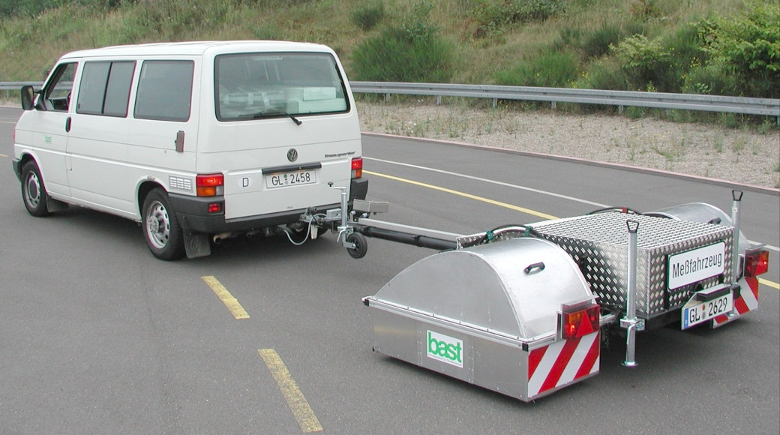
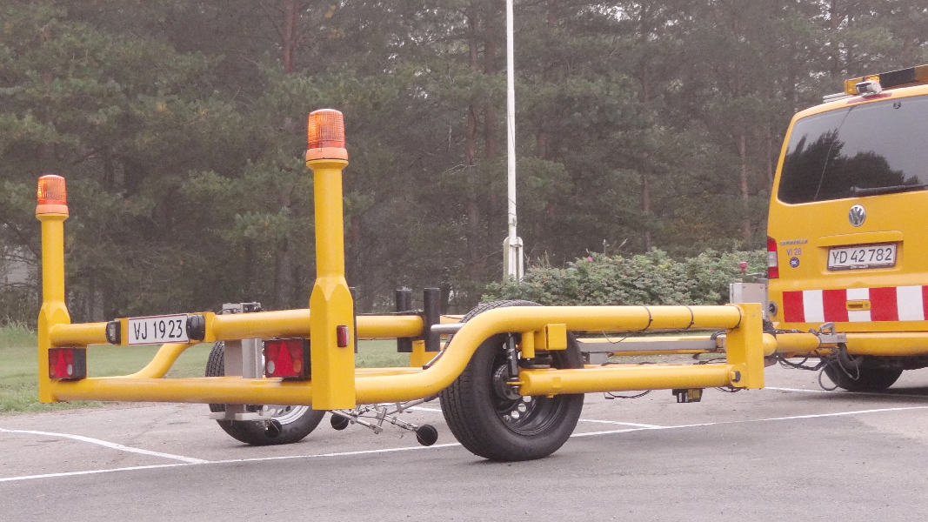
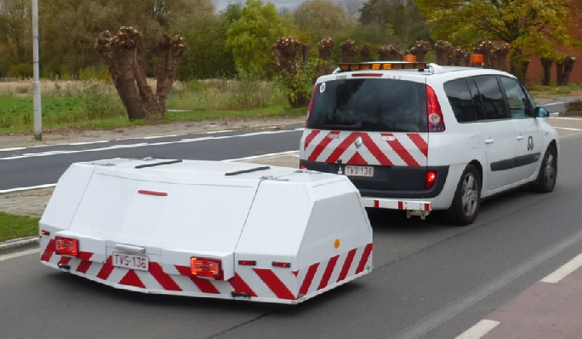

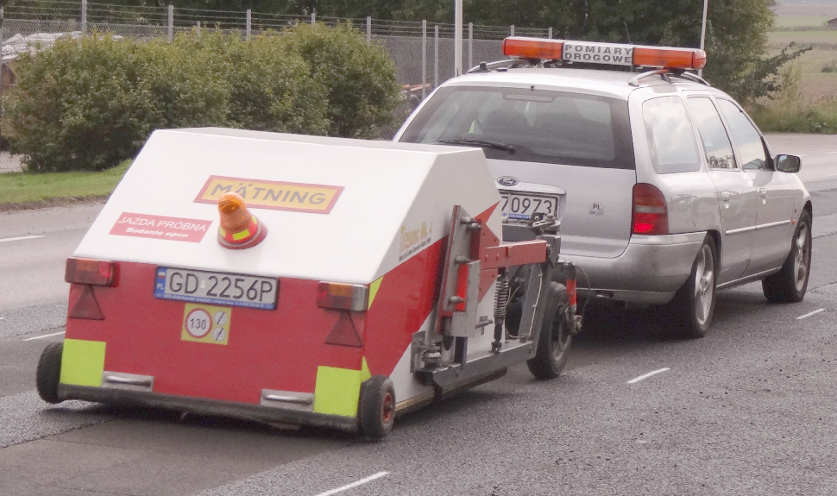
ROSANNE – Noise – Validation tests
Participating equipment:

Slide 24
ROSANNE – Noise – Validation tests
Questions to be answered:
What is the spread in test sections within similar road surfaces?
What is the spread in test sections between diff. batches of mixes?
What is the spread in test sections between diff. contractors laying nominally the same mix?
How many test sections of a road surface need to be tested (2 or more)?
What is the spread between diff. CPX equipment?

Slide 25
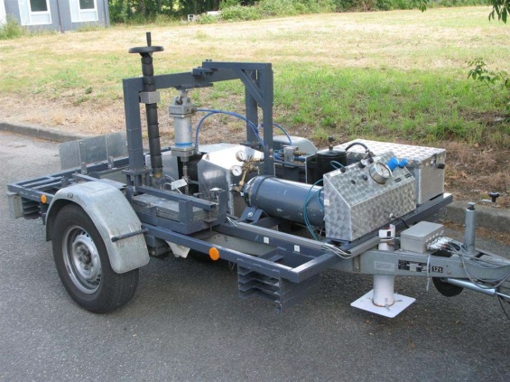
ROSANNE WP 3 – Rolling resistance
Measurement methods for rolling resistance properties of road surfaces
Starting point
Rolling resistance (ISO) measurement standard exists for tyres (using lab drum)
But no standard exists for pavement contribution to rolling resistance
Several measurement trailers have been developed
Other methods possible:
  Drum tests with replica road surfaces
  Coast-down measurements
  Fuel consumption measurements

Slide 26
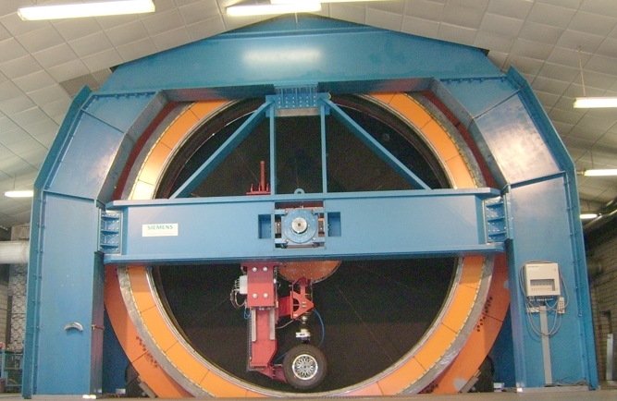
ROSANNE – Rolling resistance
Objectives:
Representative and accurate classification of road surface rolling resistance
Development of the tentative trailer method for measurement of rolling resistance into a standardized method (ultimately CEN)
Investigation of influencing parameters, calibration procedures
Comparison and link to other RR test methods

Slide 27
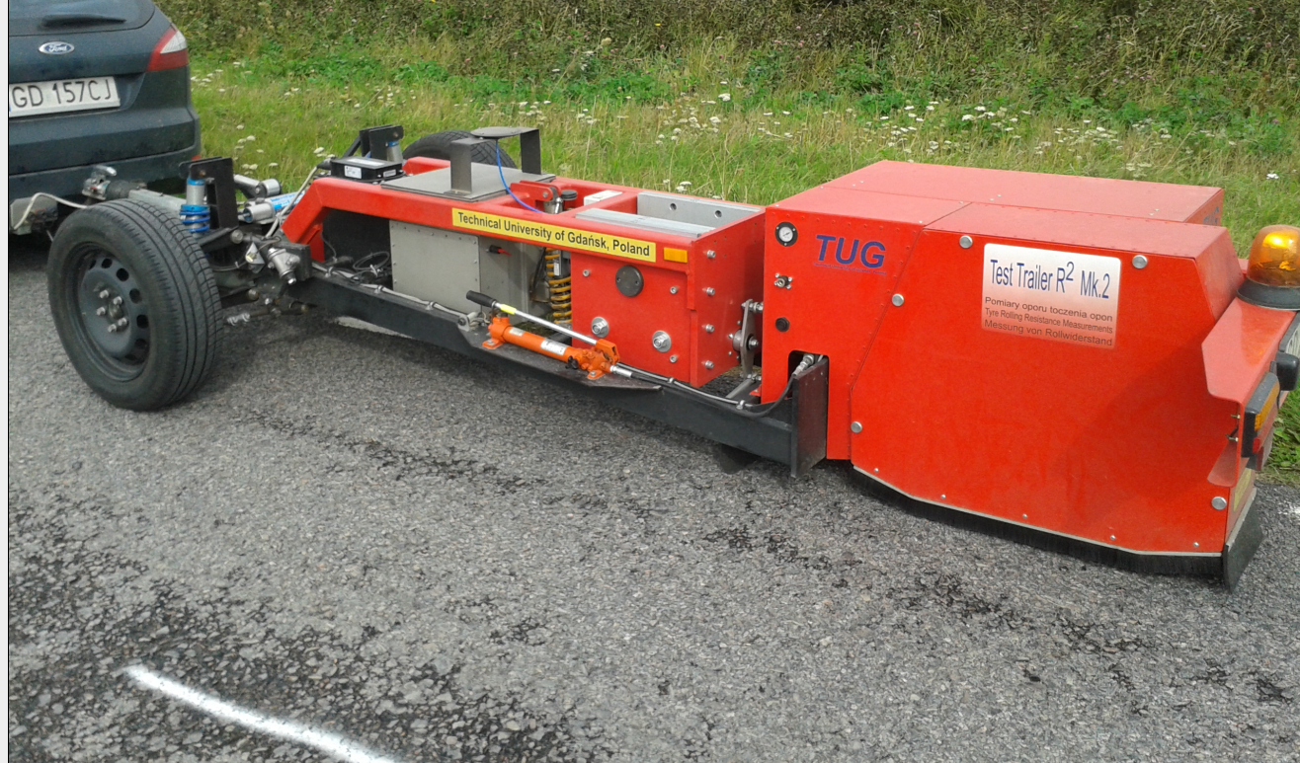
ROSANNE – Rolling resistance
Activities:
Investigation of influencing parameters
Comparison to alternative test methods and relation to full vehicle energy consumption
Robust calibration methods for trailers
Development of technical input for standardization, producing a draft standard
Validation testing (comparison of equipment)

Slide 28
ROSANNE – Rolling resistance
Results:
Key influencing parameters established: Tyre load and inflation, temperature (tentative correction established), road surface texture
Further investigations planned on wind shielding strategies
Comparison with coast-down and drum testing performed
Comparison testing performed on IFSTTAR test track in Nantes, France, with 3 devices – analysis ongoing
Preparation of input to standardization ongoing

Slide 29
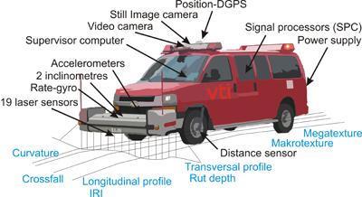
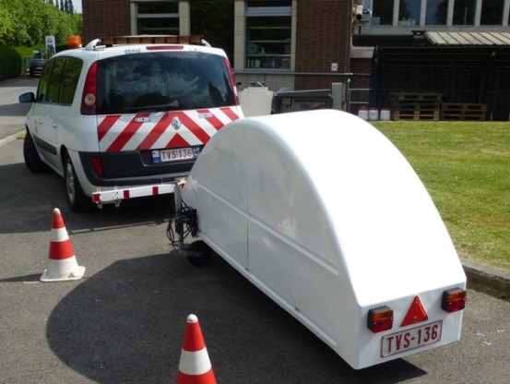
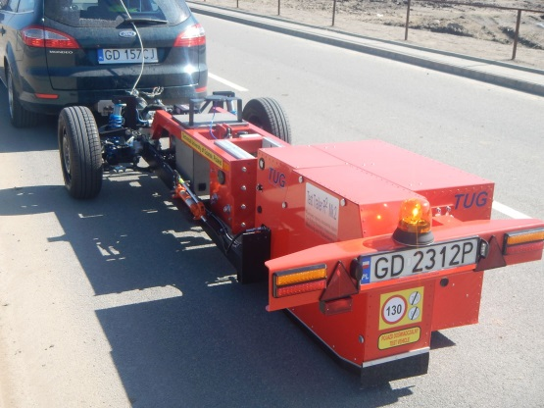
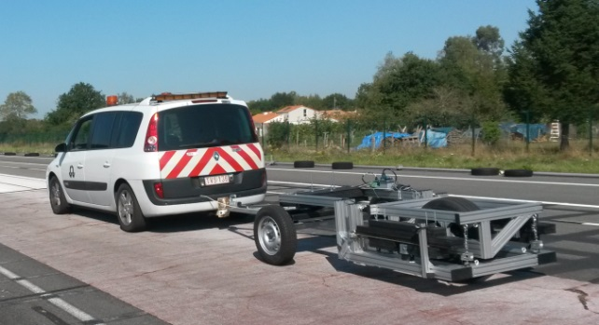
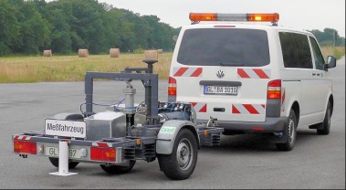
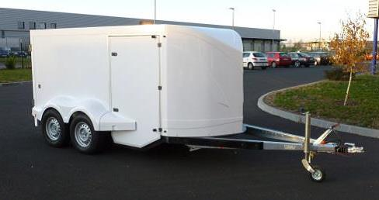
RRT: Participants
RR (trailer):
  Angle measurement: BRRC, TUG
  Force measurement: BRRC, BASt, COLAS
Texture and unevenness:
  Road Surface Tester (RST): VTI
  Mobile laser profilometers: BRRC, TUG
Alternative RR methods:
  Coast down: VTI
  Energy consumption: VTI

Slide 30
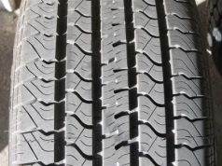
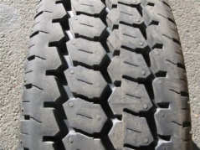
Draft standard preparation
Reference tyres: representative for passenger cars and trucks SRTT (P1) and AAV4 (H1)
Wheel dimensions for reference tyres e.g. 6.5J x 16 for P1
Reference speeds: 80, 50 and 30 km/h
Tyre load: 4 kN for P1 and H1
Tyre inflation: 210 kPa for P1 and H1

Slide 31
ROSANNE WP 4 – Common issues
Common issues: Texture measures, reference tyres and reference surfaces
Starting points
There might be more representative and comprehensive measures for texture than present MPD (ISO 13473-1)
Both the CPX method and the trailer rolling resistance method require reference tyres (ideally also the skid resistance methods)
Reference surfaces may be useful for calibration and comparison purposes
The extent of lateral variation in texture is unknown

Slide 32
ROSANNE WP 4 – Common issues
Texture measures
State-of-the-Art report about texture influence on noise and rolling resistance (Deliverable 4.1, produced by BRRC)
Measuring campaign (mainly by BASt and BRRC) in conjunction with skid resistance tests in 2014, including e.g. MPD, skewness, G factor, enveloping, 3D-measurement, extended-range into microtexture
More texture measurements in conjunction with rolling resistance tests in 2015, by VTI, IFSTTAR, BRRC and TUG.
Analyses of results are being finalized in June 2016.
Preliminary results indicate very good comparability of MPD measuring equipment, provided new and revised procedure is used (new ISO 13473-1)

Slide 33
ROSANNE WP 4 – Common issues
Reference tyres - activities
Needed for both noise and rolling resistance
They shall represent tyres for both light vehicles (cars) and heavy vehicles, since classification of surface are different for those
Both shall be small enough to fit on a large car, or on a trailer towed by car or van, yet they shall have relatively similar dimensions, for practical reasons
Made in close cooperation with ISO/TC 43/SC 1/WG 33, resulting in an ISO/DTS 11819-3 (distributed for ballot in June).
Variation between tyre samples, stability with time were explicitly researched
Relation between tyre rubber hardness and noise have been established, making possible correction for hardening of tyres with time and use

Slide 34
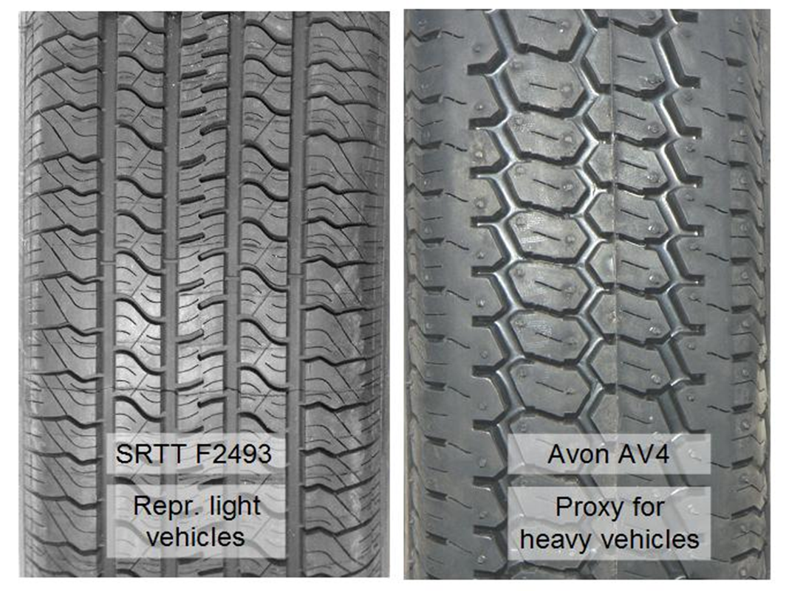
ROSANNE WP 4 – Common issues
Reference tyres

Slide 35
ROSANNE WP 4 – Common issues
Reference surfaces – for rolling resistance (RR)
A procedure has been worked out, based on the concept of a virtual reference surface (DAC11/SMA11 having a certain reference value of MPD), used for simple and fast check of RR equipment:
The corresponding Deliverable will be Part C of D4.3, which has already been prepared by BRRC and reviewed by VTI long ago.
However, a minor but important update is desirable, given the results of the rolling resistance tests in Nantes in September 2015. BRRC and IFSTTAR are working on this.
Deadline for the updated Deliverable is 30 June 2016.

Slide 36
ROSANNE WP 4 – Common issues
Reference surfaces – for noise
CNOSSOS-EU has issued a final report on road traffic noise prediction and there is now also a Directive (EU) 2015:996
They use the concept of Virtual Reference Surface, which is a mix of DAC 11 and SMA 11.
It is not perfectly expressed and ROSANNE will develop it further, both for the CNOSSOS purpose but also for a wider use.
The upcoming “validation test” for noise properties of road surfaces will have a certain focus on the virtual reference surface types DAC 11 and SMA 11. This might be useful for D4.3.
The Deliverable for this will be Part B of D4.3. The new deadline is 30 June 2016.

Slide 37
ROSANNE WP 4 – Common issues
Lateral variation on the road surface in Europe
Measurements were using the VTI Laser RST system. All kinds of texture, unevenness, and other geometrical measurements were made while driving a 2000 km “circle” from Linköping, Sweden, through southwestern Denmark, northern Germany, through northern Poland, and back through southeastern Sweden to Linköping.
Data useful in WP 1, 2 and 3 to determine in which lateral position one shall do measurements.
Deliverable D4.4 ”Variation of road surfaces in transverse direction”, is now ready. The VTI RST group is responsible.

Slide 38
ROSANNE info
ROSANNE website
www.rosanne-project.eu
ROSANNE final event
Where: Belgian Road Research Centre (BRRC)
Fokkersdreef 21, 1933 Sterrebeek/Brussels, Belgium
When: 11 October 2016, 10:00 – 16:00

Slide 39
ROSANNE contact
Presenter:
Ulf Sandberg, VTI, Sweden
ulf.sandberg@vti.se
Coordinator:
Manfred Haider
AIT Austrian Institute of Technology GmbH, Vienna, Austria
manfred.haider@ait.ac.at

Slide 40
Acknowledgement
It is gratefully acknowledged that
much of this presentation is based on a presentation at TRA 2016,
made by Manfred Haider, AIT
But Ulf Sandberg has edited, processed and significantly supplemented it

Slide 41
The end
The End

