Slide 1


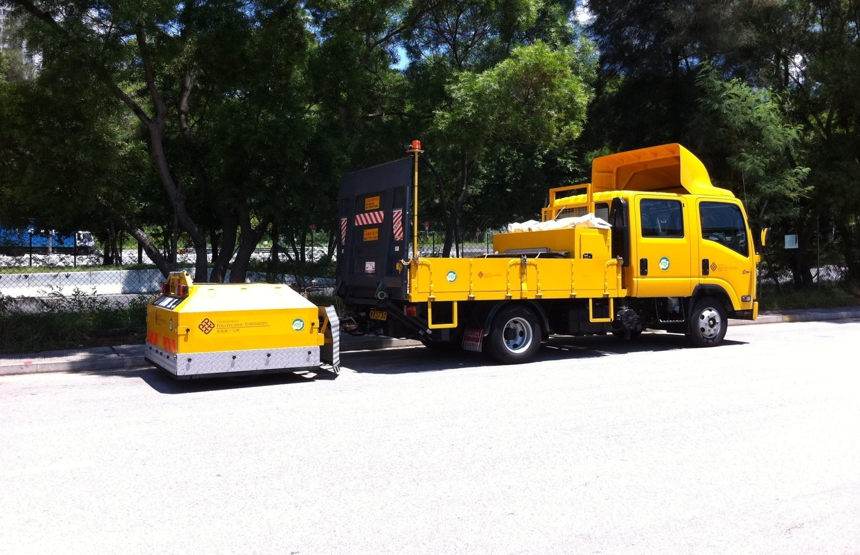
Contributions To Close-Proximity Method for Tyre/Road Noise Measurement in Highly Urbanized City
Yat Ken LAM^{C}, Randolph Chi Kin LEUNG¹, Wing Tat HUNG²
¹Department of Mechanical Engineering
²Department of Civil and Environmental Engineering
The Hong Kong Polytechnic University
Hung Hom, Kowloon, HONG KONG
Opening Minds ⋅Shaping the Future

Slide 2
Content
Introduction
PolyU Mark II Twin-Wheeled CPX Trailer
Temperature Effect on Tyre/road Noise
Road Curvature Effect on Tyre/road Noise
Vibration-induced Error in CPX Microphone Signal
Summary & Conclusions

Slide 3

Introduction
Hong Kong (1104 km² with 7.3 million population)

Slide 4

Introduction
Hong Kong (1104 km² with 7.3 million population)

Slide 5
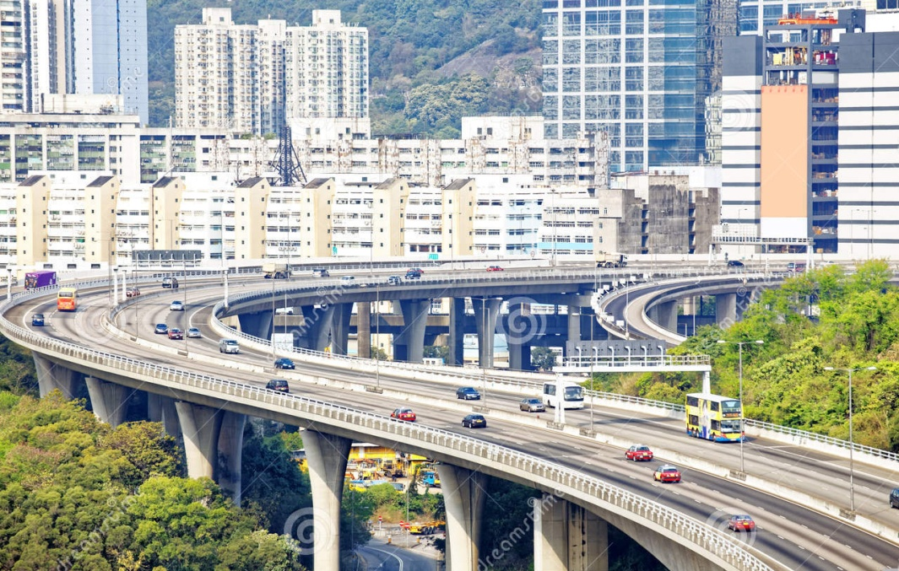
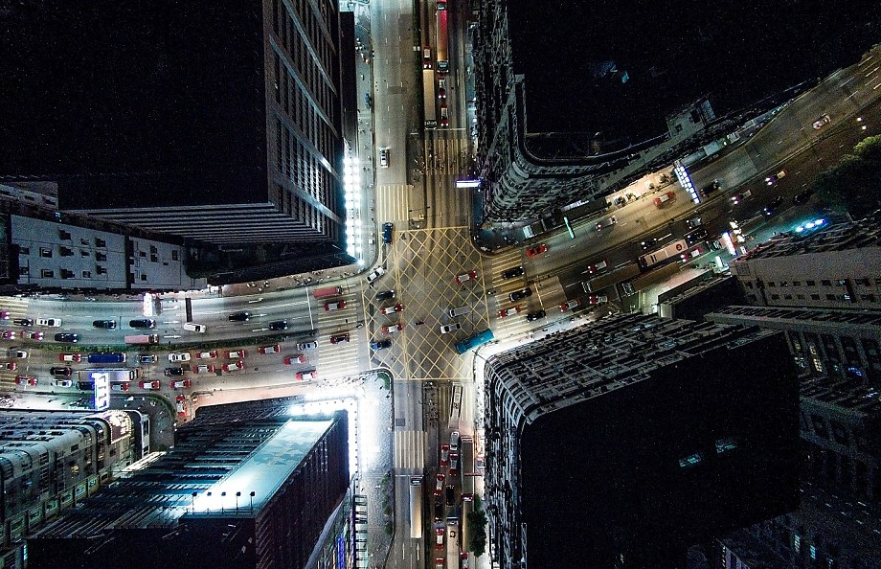

Introduction
Hong Kong (1104 km² with 7.3 million population)

Slide 6
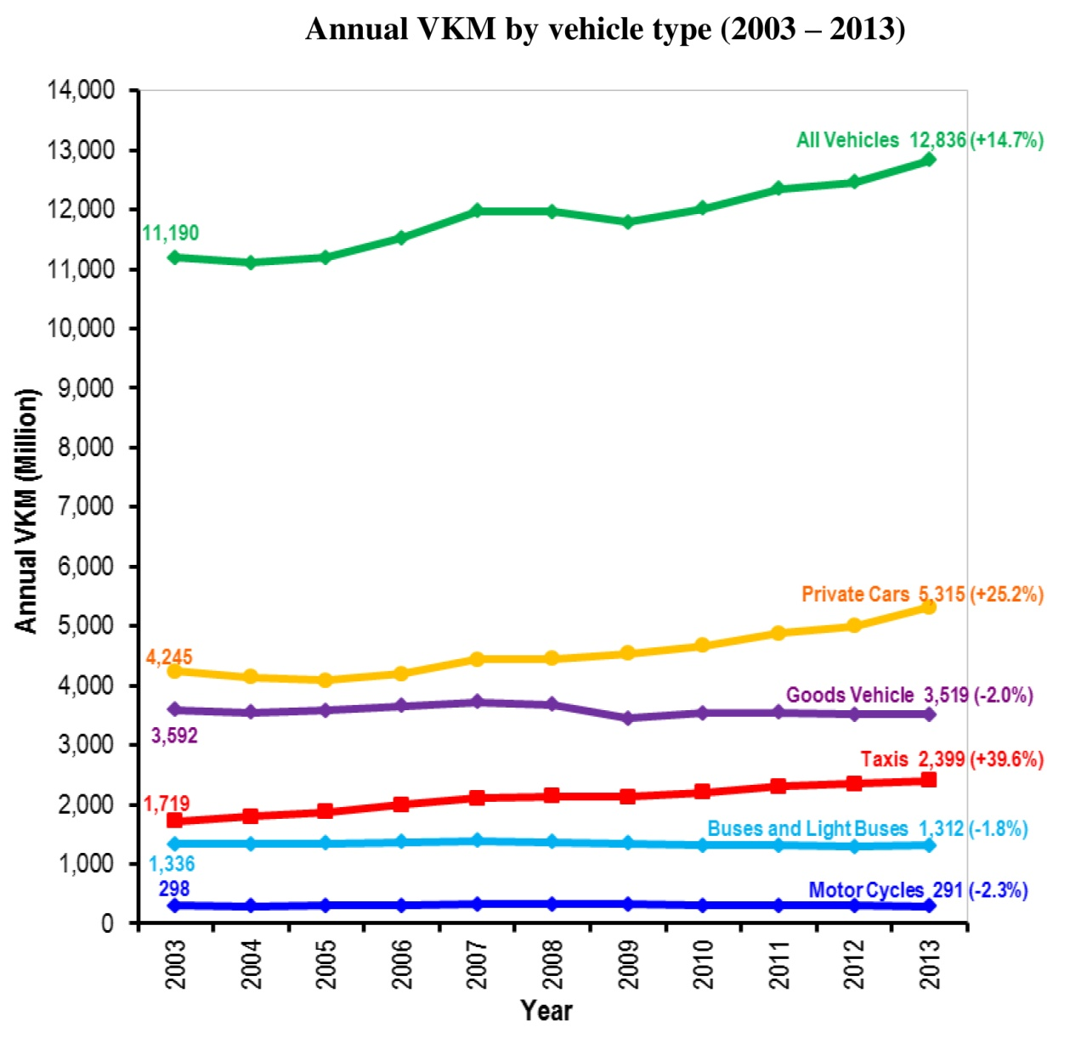
Introduction
Dominant traffic
noise source
(> 40 km/h)
Evolving role
    Electric/hybrid
    vehicle
    Popular local
    Government’s
    Noise Mitigation
    Measures

Slide 7
PolyU Mark II Twin-Wheeled CPX Trailer

Slide 8
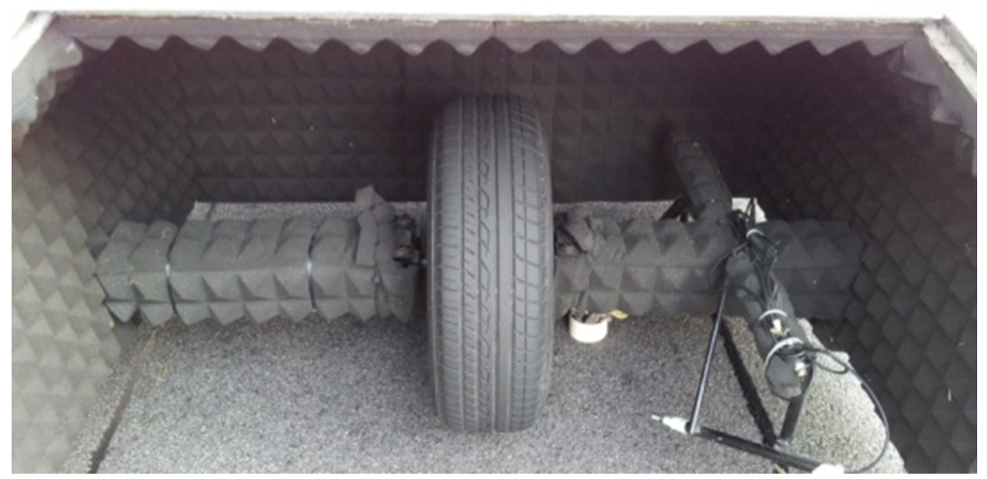
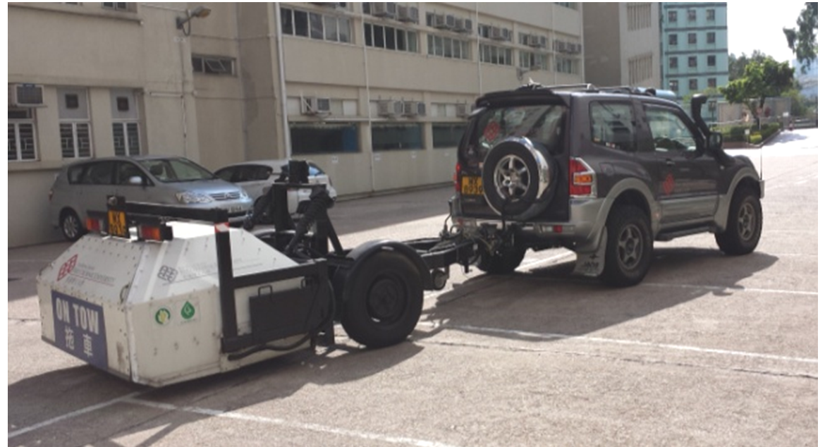
Background
Predecessor: PolyU Mark I Single-wheeled CPX Trailer
  Acoustic closure
  1 test at middle of road lane
  2 supporting wheels

Slide 9
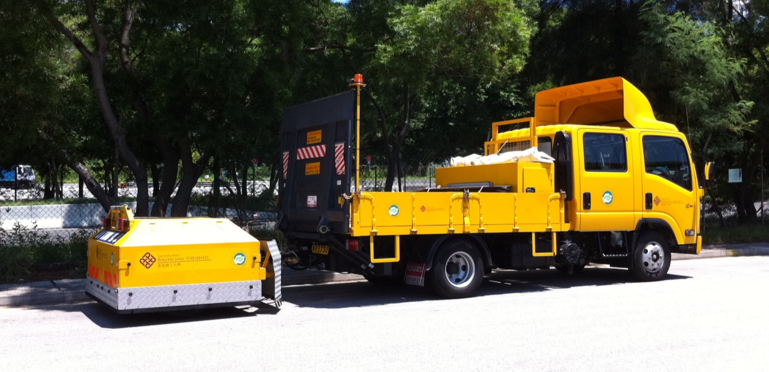

PolyU Mark II Twin-Wheeled CPX Trailer
Measurement method
  Close-Proximity (CPX) Measurement (ISO 11819-2)

Slide 10
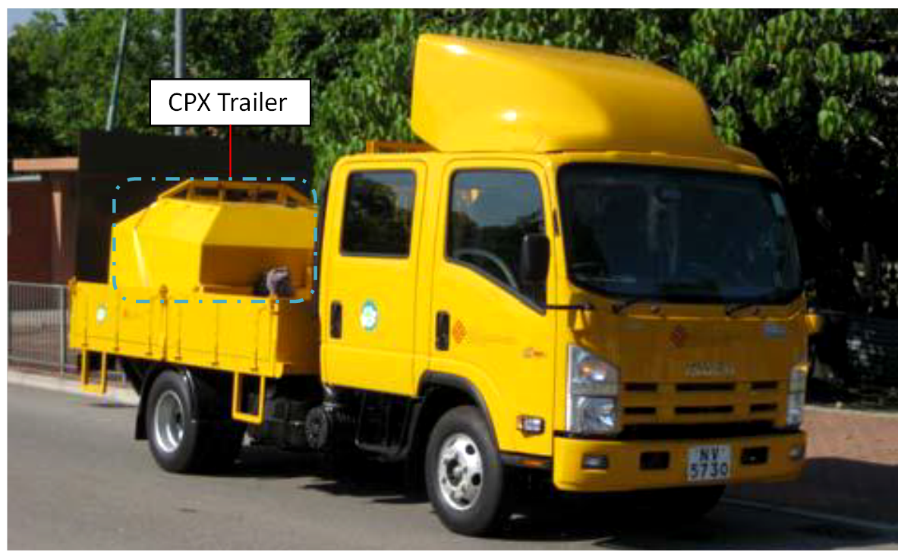
PolyU Mark II Twin-Wheeled CPX Trailer
Extended test tyres usage life

Slide 11
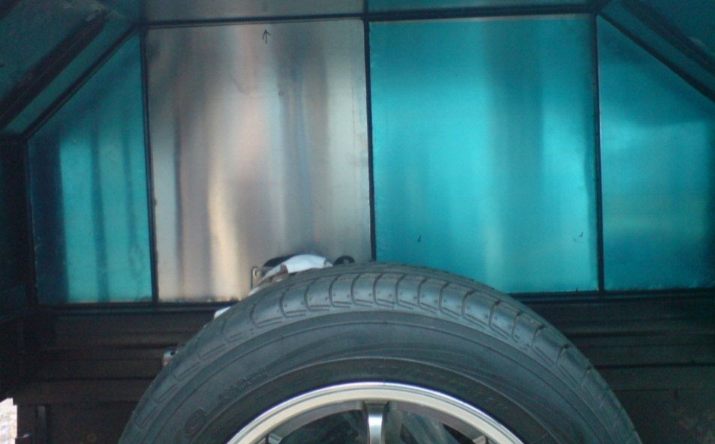
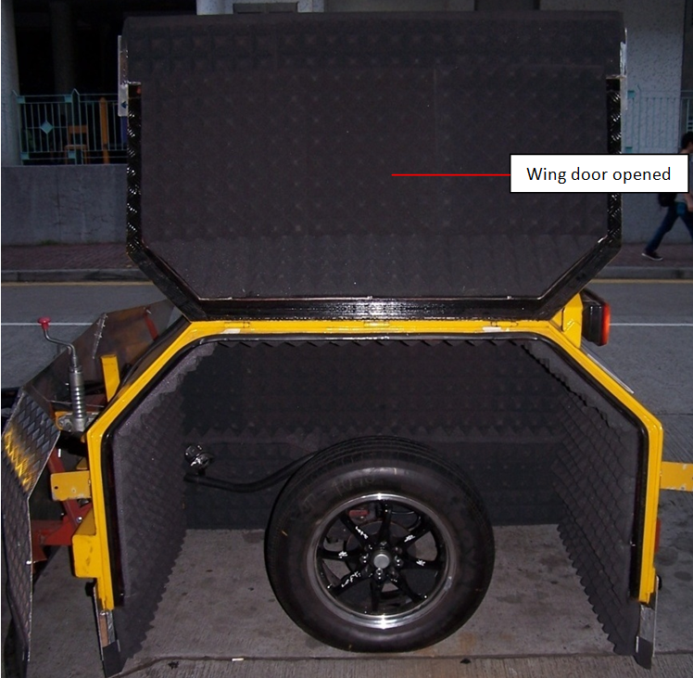
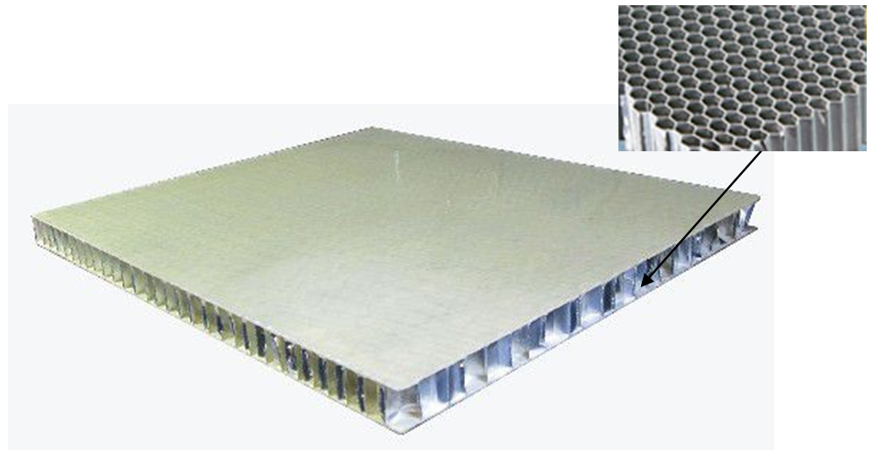
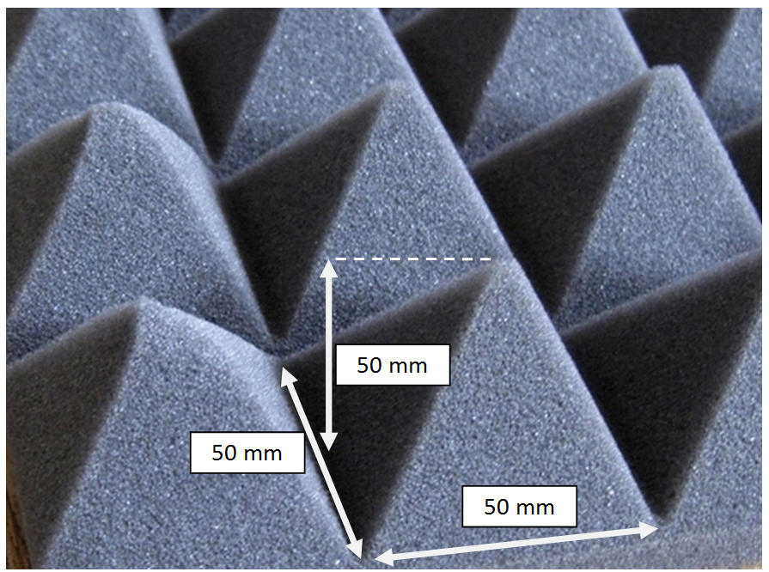
PolyU Mark II Twin-Wheeled CPX Trailer

Slide 12
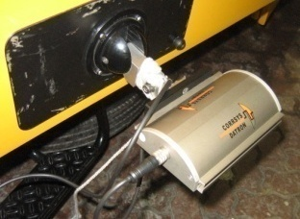
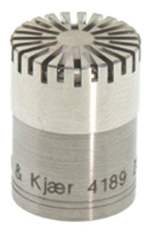
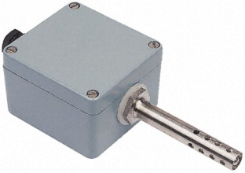
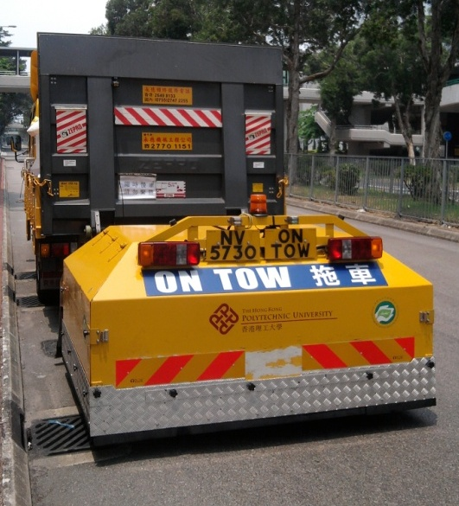
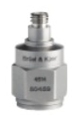
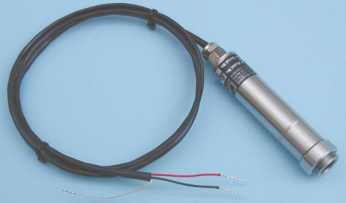
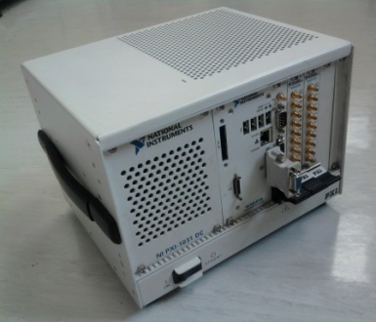
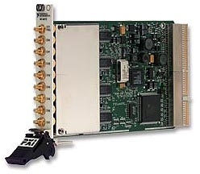
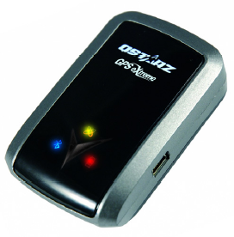
Instrumentation
Speed sensor
Air temperature sensor
Microphone
Accelerometer
Pavement surface temperature sensor
Data Acquisition Device
GPS Receiver

Slide 13
Temperature Effect on Tyre/road Noise

Slide 14

Tyre/road noise level and temperature
Thermoplastic tyre rubber
  ∆T → ∆stiffness → ∆structure-borne noise → ∆SPL
Numerous studies:
  T↑ → SPL↓ linearly
ISO 11819-2 normalization to T_{air} at 20°C
.
  a : temperature constant (dB(A)/ °C)
  Tyre/road dependant → knowledge gap

Slide 15
Test for temperature effect on tyre/road noise
Common road surface types
  4 x WC sections
  4 x SMA sections
50 km/h
Duration to achieve ∆T……

Slide 16
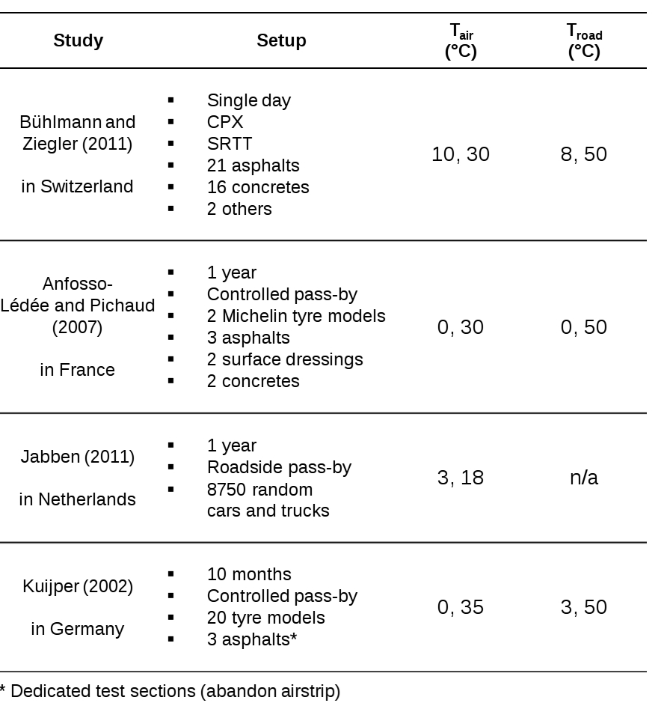
Test for temperature effect on tyre/road noise
Natural weather ∆T
  Seasonal
    Relatively large ∆T
    ∆Tyre
    ∆Road
  Day-to-night
    Relatively small ∆T
    Negligible ∆Tyre
    Negligible ∆Road

Slide 17
Test for temperature effect on tyre/road noise
Constraints in HK
  No especially test section
    deteriorating public roads with urban traffic flow
Advantage in HK
  Subtropical region
    Medium daily ∆T in summer

Slide 18
Test for temperature effect on tyre/road noise
We developed “single-day test”
  Summer: daytime & nighttime
  Common surfaces
    SMA x 4 sections
    WC x 4 sections
  SRTT
  50 km/h
  Air & road surface temperatures

Slide 19
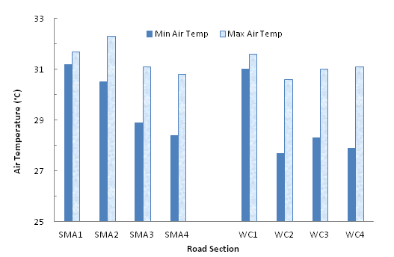
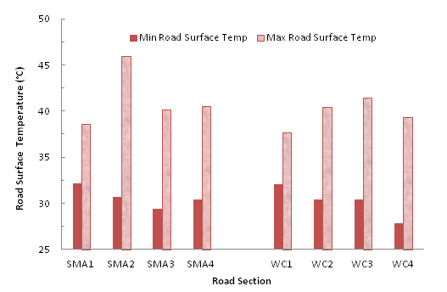
Evaluation of test method
Air temperature
Road surface temperature

Slide 20
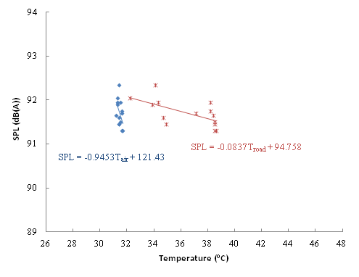
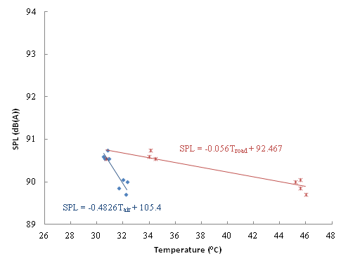
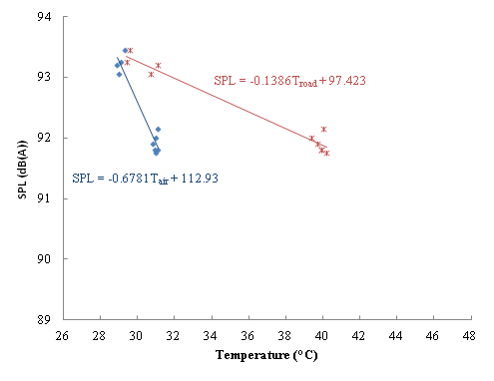
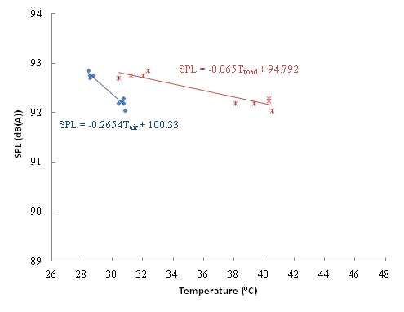
Evaluation of test method
SMA 1
SMA 2
SMA 3
SMA 4

Slide 21
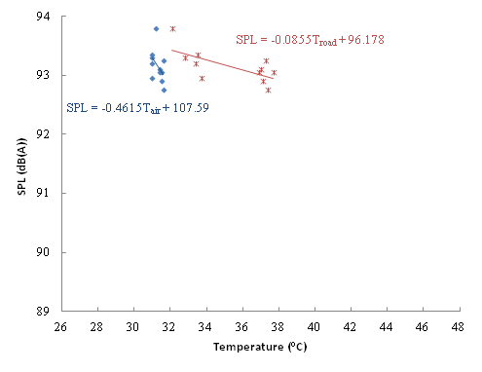
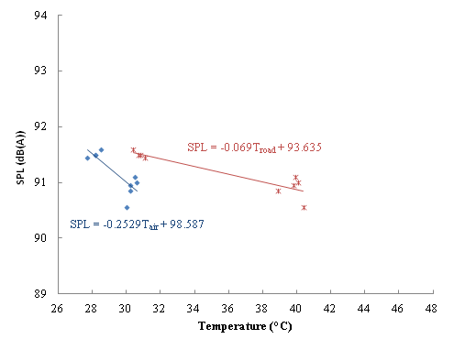
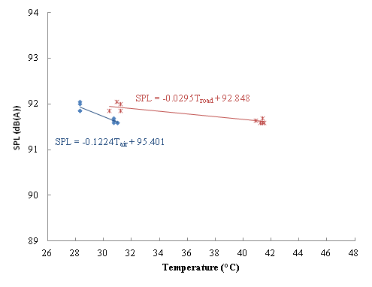
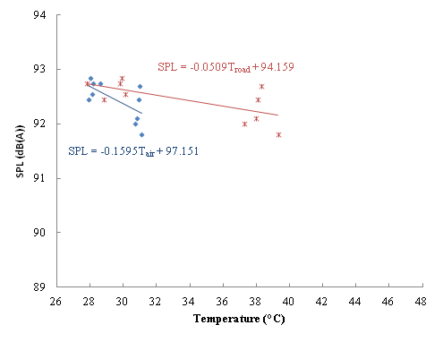
Evaluation of test method
WC 1
WC 2
WC 3
WC 4

Slide 22
Better temperature descriptor
Temperature correction
  Effect estimation → compensation

Slide 23
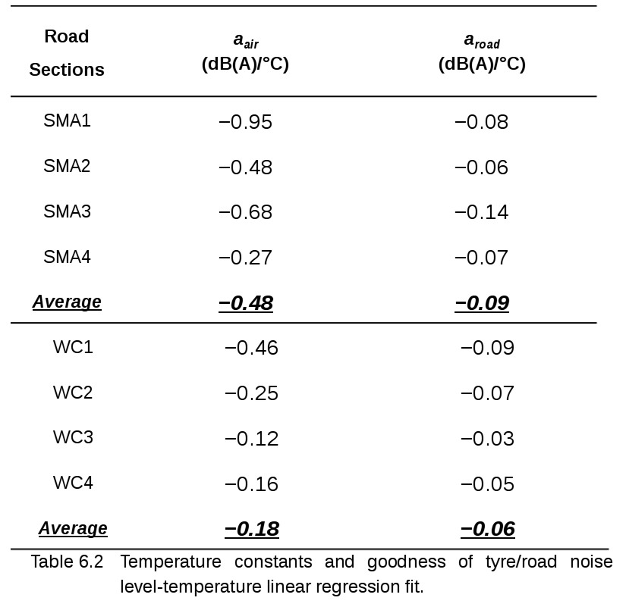
Temperature constants

Slide 24
Study | Setup | T_{air} (°C) | a_{air} (dB(A)/°C) | T_{road} (°C) | a_{road} (dB(A)/°C)
This study in Hong Kong | Single day CPX SRTT tyres 8 asphalts | 27, 32 | –0.12, –0.68 | 30, 46 | –0.03, –0.14
Bühlmann and Ziegler (2011) in Switzerland | Single day CPX SRTT 21 asphalts 16 concretes 2 others | 10, 30 | –0.1 | 8, 50 | n/a
Anfosso- Lédée and Pichaud (2007) in France | 1 year Controlled pass-by 2 Michelin tyre models 3 asphalts 2 surface dressings 2 concretes | 0, 30 | –0.06, –0.1 | 0, 50 | –0.04, –0.06
Jabben (2011) in Netherlands | 1 year Roadside pass-by 8750 random passenger cars and trucks | 3, 18 | –0.03* | n/a | n/a
Kuijper (2002) in Germany | 10 months Controlled pass-by 20 tyre models 3 asphalts | 0, 35 | –0.04, –0.13 | 3, 50 | –0.02, –0.13

Slide 25
Road Curvature Effect on Tyre/road Noise

Slide 26
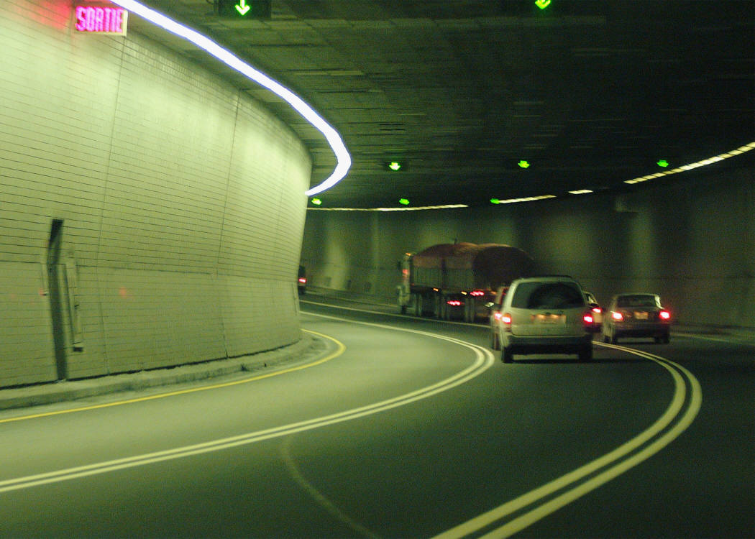
Road curvature effect on tyre/road interaction
Centripetal Force
By friction at tread/pavement
Tread blocks deformation
∆tread impact, ∆ stick-slip, ∆ stick-snap
∆SPL → unfair comparison

Slide 27
Road curvature effect on tyre/road noise
ISO/CD 11819-2 (2010)
  S7.1 Selection of measuring site:
“The road section shall not include bends with a radius of curvature less than 250 m at 50 km/h and 500 m at 80 km/h.”

Slide 28
Test for road curvature effect on tyre/road noise
Criteria of test sections
  Safety
  Medium to high speed
  Range of radii
  Similar surface conditions

Slide 29
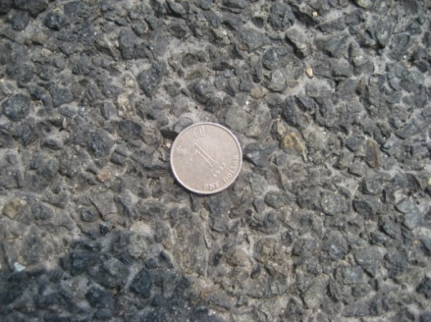
Test for road curvature effect on tyre/road noise
Tolo Highway
  1 straight road section
  8 curved road sections
    radii: 478 – 668 m
  Friction Course (Porous)
    Max. chipping size: 10 mm
    Thickness: 30 mm
  50 & 70 km/h
2.5 cm

Slide 30
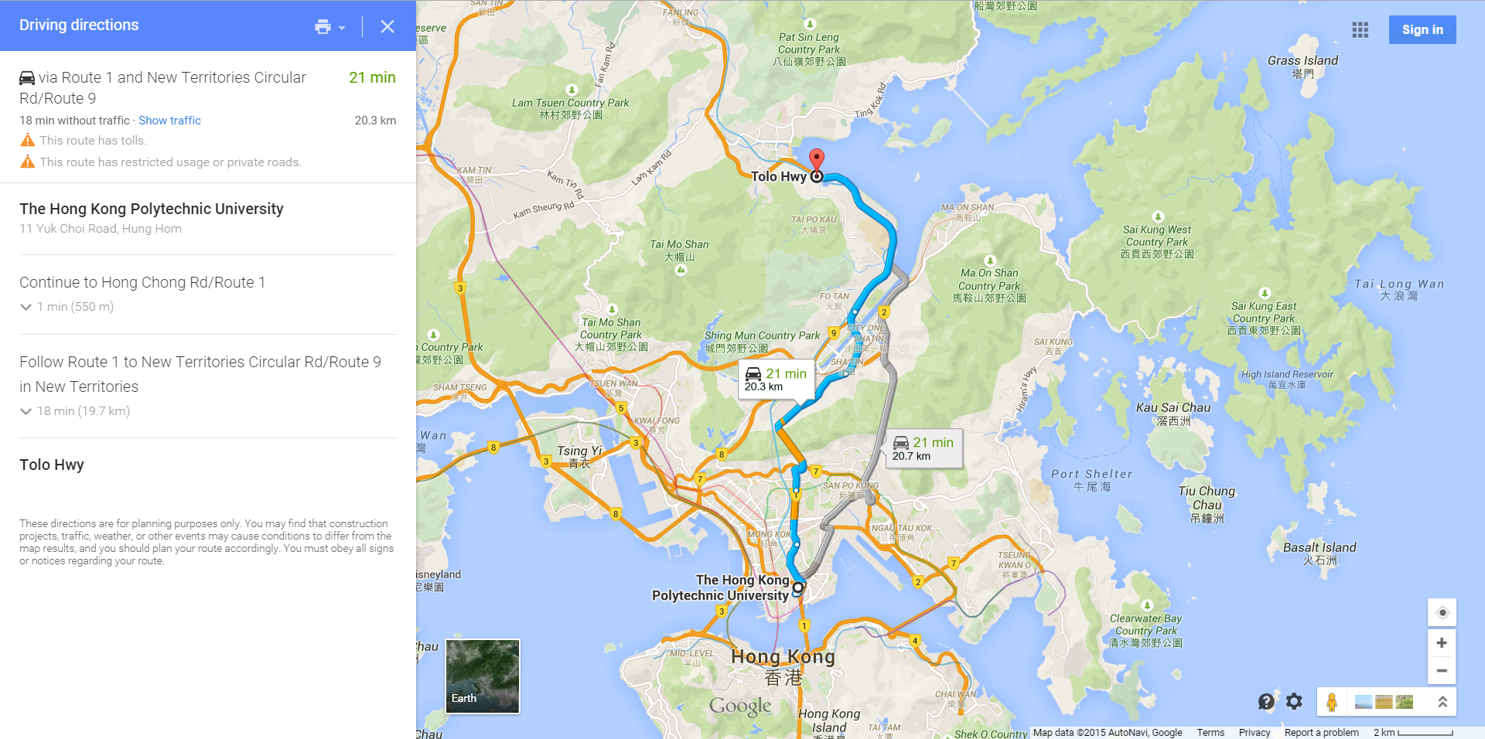
Test for road curvature effect on tyre/road noise
Warm-up: 20 km travel for 20 minutes
At least 5 runs for each road section
Completed within half day

Slide 31
Test for road curvature effect on tyre/road noise
Road Index | Location (Chainage) | Radius (m) | Road Surface Type | Ref. Speed (km/h)
C1 | 9.4 – 9.6 | 479 | Friction Course# (FC) | 50 & 70
C2 | 10.7 – 11.4 | 601
C3 | 12.5 – 13.0 | 583
C4 | 14.5 – 14.8 | 588
C5 | 14.8 – 14.5 | 587
C6 | 13.0 – 12.3 | 601
C7 | 11.4 – 10.7 | 664
C8 | 16.0 – 16.1 | 555
S1 | 15.1 – 14.9 | /

Slide 32
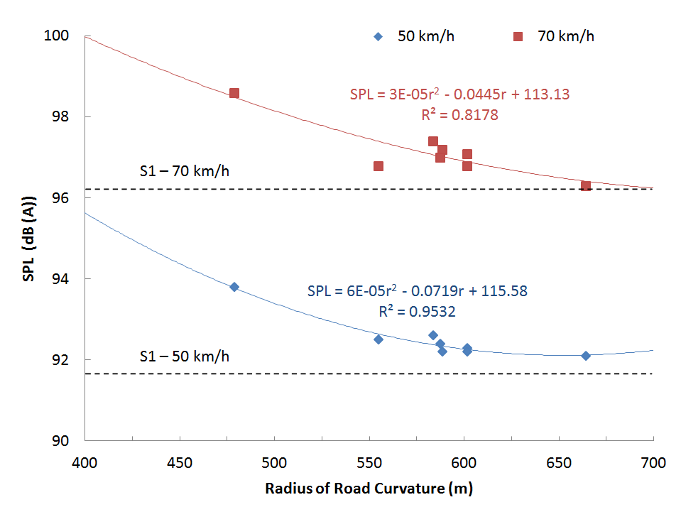
Results and findings

Slide 33
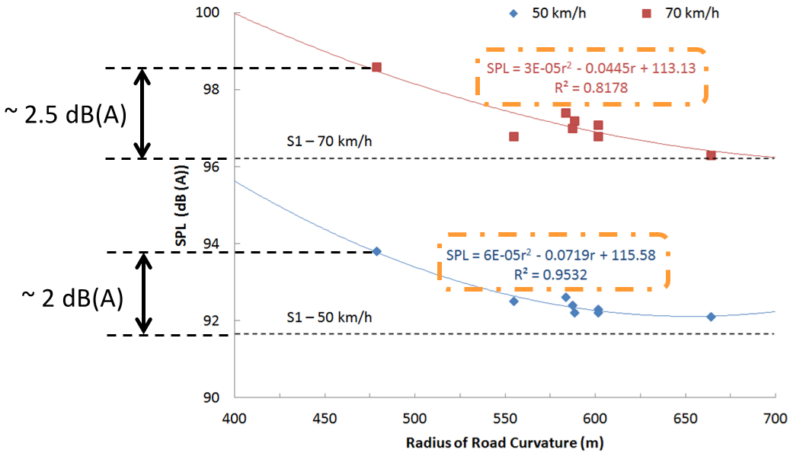
Results and findings

Slide 34
Results and findings
Critical radius
  at which “curved” road is regarded “straight”
  (from differentiating the fits)
Ref. Speed (km/h) | Fitting line | Critical radius: r (m)
50 | SPL₅₀ (r) = 6×10⁻⁵ r² – 0.0719 r + 115.58 [R² = 0.9532] | 599
70 | SPL₇₀ (r) = 3×10⁻⁵ r² – 0.0445 r +113.13 [R² = 0.8178] | 742

Slide 35
Results and findings
50 km/h
70 km/h

Slide 36
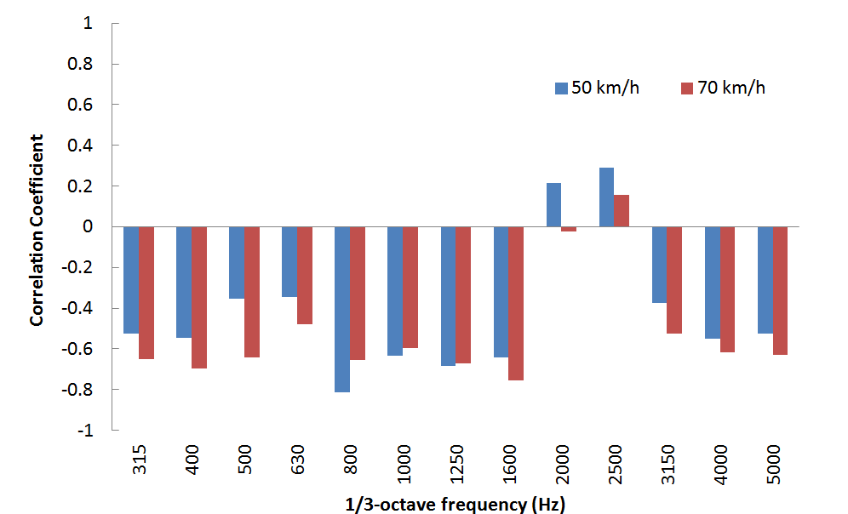
Results and findings
Correlation between band level and radius of road curvature
Tread Impact
Stick-snap

Slide 37
Vibration Induced Error in CPX Microphone Signal

Slide 38
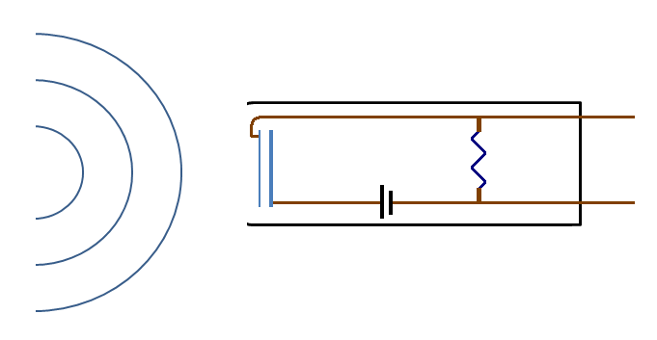
Vibration-induced error
Diaphragm
Back plate
Sound Pressure Signal
plausible
error
+
Sound
Microphone
Vibration
Diaphragm/back plate:
relative displacement
Sound wave
Sound pressure signal
+ plausible error
SPL _{Measured} = SPL _{Sound} + E _{Vibration}
Microphone vibration

Slide 39


Hypothesis & test principle
Relationship between noise level, vibration & error
Definition of error
Controlled vibration prescription
Controlled sound source

Slide 40
Test Methodology
Laboratory test
  Replica of trailer frame
  Sound source: speaker (white noise)
  Vibration: shaker
Trailer on-deck test
  Simulate standard measurement
  Sound source: speaker (white noise)
  Vibration: transmitted from ground

Slide 41
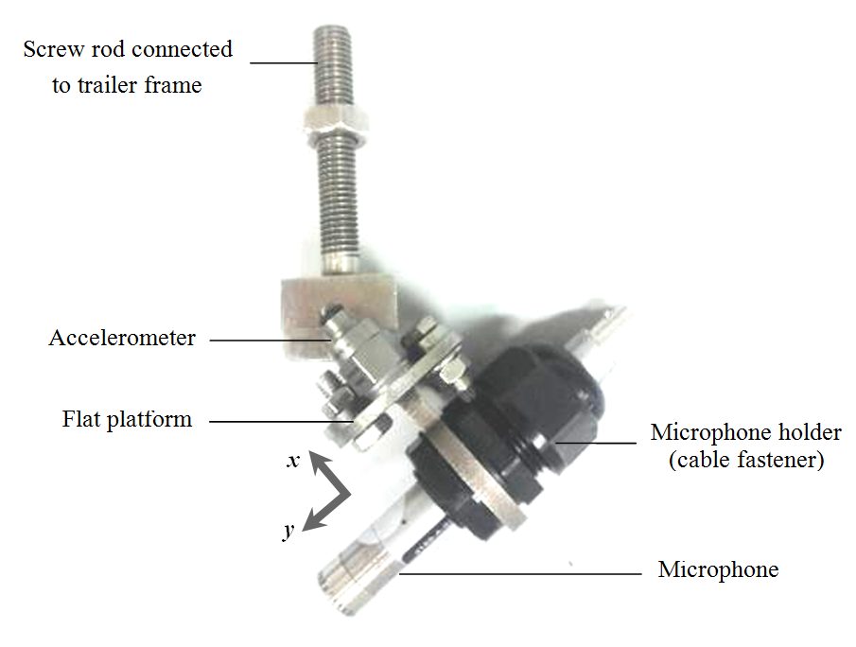
Monitor microphone vibration

Slide 42
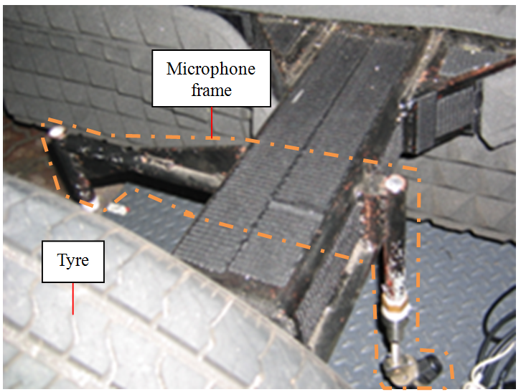
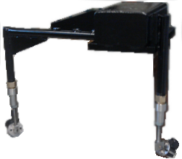
Laboratory test

Slide 43
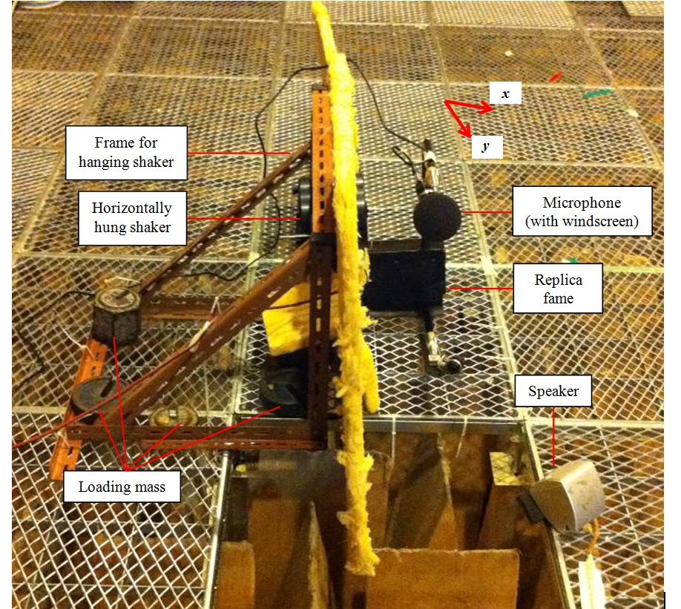
Laboratory test
3-minute warm-up
315 – 500 Hz per ISO/CD 11819-2 (2010)
5 30-second runs

Slide 44
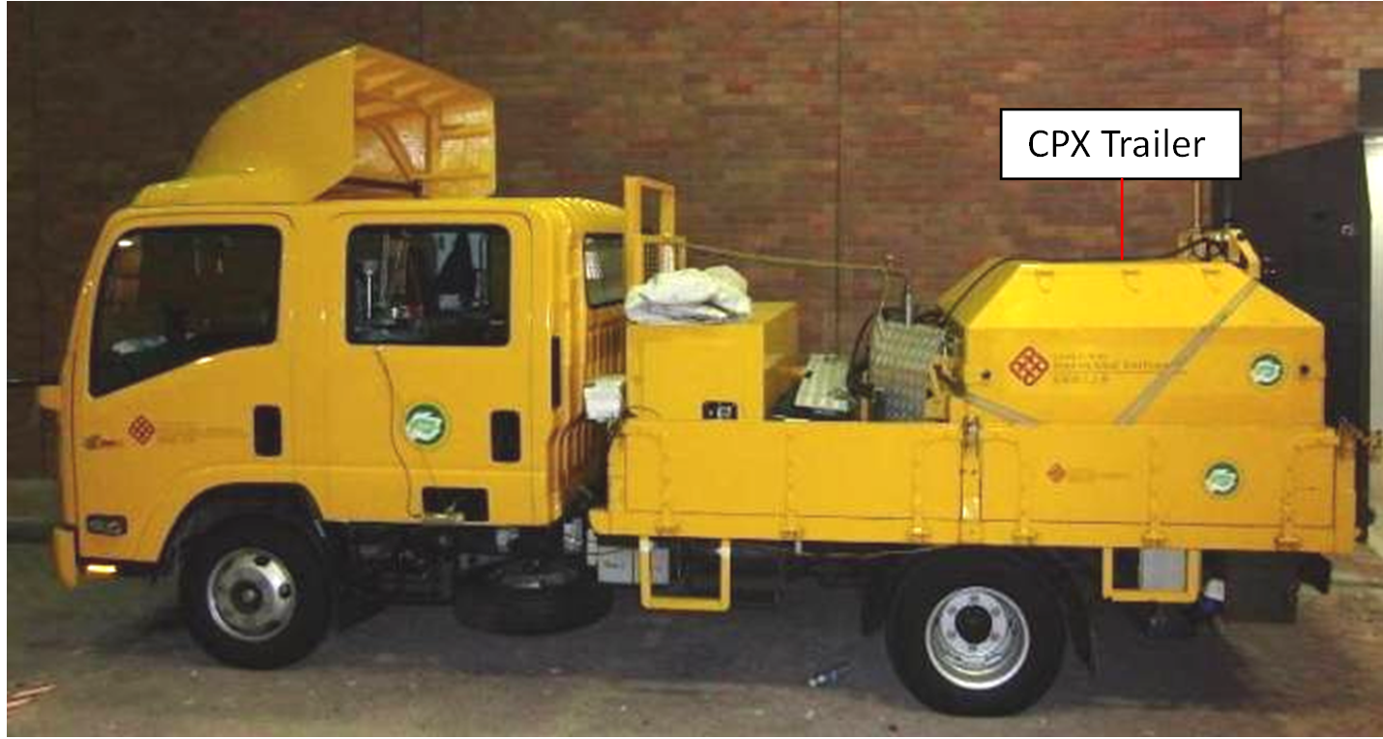
Trailer on-deck test
Trailer on deck → removal of tyre noise
Controlled noise: speaker (white noise)
Vibration: on-road travelling
3-minute warm-up
Parked / travelling
3 30-second runs

Slide 45
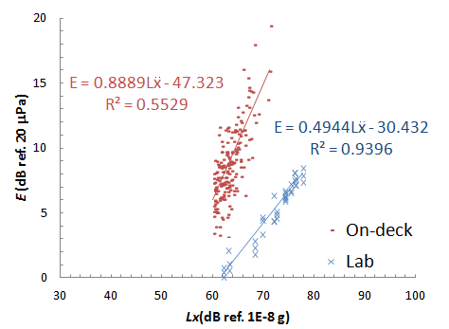
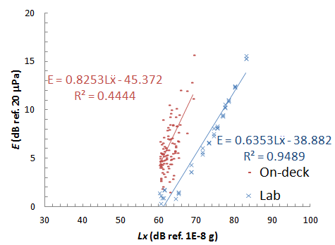
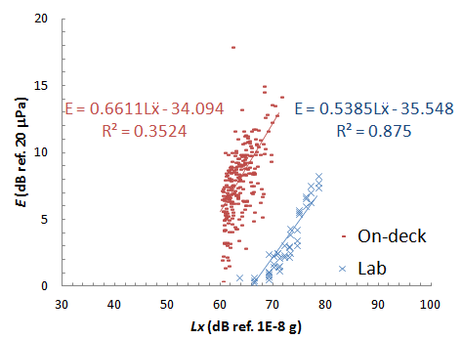
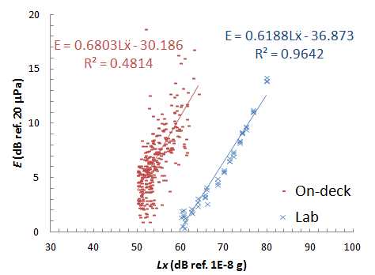
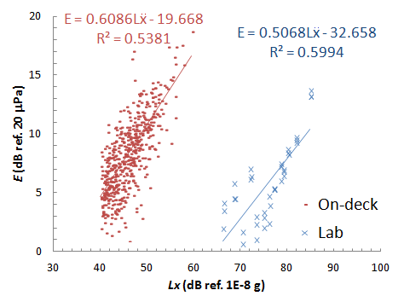
Results
315 Hz | 400 Hz | 500 Hz
800 Hz | 1000 Hz

Slide 46
Results
Slope of vibration-induced error to vibration level

Slide 47

Results
Regression lines → Error estimation → Compensation

Slide 48
Evaluation study
Background details
Location | Road Surface | Ref. Speed (km/h) | Measurement Type | Tyre | Remarks
Cheung Sha Wan Road* | Dense Asphalt Concrete | 70 | CPX measurement | Standard Reference Test Tyre (SRTT) | Microphone vibration monitored
* Hing Wah Street to Tonkin Street

Slide 49
Evaluation study
Measured microphone vibration spectrum

Slide 50

Evaluation study
Measured & corrected noise spectra
 | Measured | Corrected (Lab) | Corrected (On-road)
SPL (dB(A)) | 101.6 | 100.5 | 98.3

Slide 51
Choice original/corrected results
Original, “lab-corrected” or “trailer on-deck-corrected”
Tyre/road Noise Level | Suggested Application
Original | Flat and smooth road sections (e.g. newly paved).
Lab-corrected | Low speed (e.g. below 50 km/h) Road sections with pavements already in use but not heavily defected (e.g. mild crack and raveling).
Trailer on-deck-corrected | Road sections with heavy defects in the pavement (e.g. potholes and delamination).

Slide 52
Summary

Slide 53
Summary
PolyU Mark II Twin-Wheeled CPX Trailer
Temperature Effect on Tyre/road Noise
Road Curvature Effect on Tyre/road Noise
Vibration-induced Error in CPX Microphone Signal

Slide 54

The authors gratefully acknowledge the funding support from Environment Conservation Fund (ECF), Hong Kong SAR Government and
Woo Wheelock Green Fund (WWGF) under grant no. ECF25/2010.

Slide 55
Certification
ISO/CD 11819-2 (2010)
  Field measurement
  Background noise disturbances
Test 1: Sound reflection against enclosure and other objects near the microphones
Test 2: Background noise from the vehicle itself or its operation
Test 3: Sensitivity to disturbance from other traffic

Slide 56


Test 1: Sound reflection against enclosure and other objects near the microphones
Setup – Case A (with enclosure)
Setup – Case B (without enclosure)

Slide 57

Test 1: Sound reflection against enclosure and other objects near the microphones
Sound source: omni-directional tube
  Reach as many as reflecting surfaces
Components | Spectral directivity pattern

Slide 58


Test 1: Sound reflection against enclosure and other objects near the microphones
Ensure negligible background noise compared to noise source
With enclosure | Without enclosure

Slide 59


Test 1: Sound reflection against enclosure and other objects near the microphones
Difference with/without
enclosure
Mic. 1

Slide 60
Test 2: Background noise from the vehicle itself or its operation
To ascertain negligible noise disturbances from the towing vehicle
  E.g. engine and exhaust noises
Control test with/without test tyres
Criterion:
  For 40, 50 & 80 km/h
  i)
  ii)

Slide 61

Test 2: Background noise from the vehicle itself or its operation
Setup – Case A (with tyres)
  i.e. Standard CPX measurement

Slide 62


Test 2: Background noise from the vehicle itself or its operation
Setup – Case B (without tyres)

Slide 63

Test 2: Background noise from the vehicle itself or its operation
For 40, 50 & 80 km/h (on friction road surface)
  i)

Slide 64



Test 2: Background noise from the vehicle itself or its operation
For 40, 50 & 80 km/h
  ii)

Slide 65

Test 3: Sensitivity to disturbance from other traffic
To ascertain the noise disturbances from the vehicles passing by at adjacent lanes
Standard CPX measurement v.s. Parked-trailer measurement
Criterion:
  Passage of 20 passenger cars & 20 heavy vehicles

Slide 66

Test 3: Sensitivity to disturbance from other traffic
Setup – Case B (Parked trailer measurement)

Slide 67


Test 3: Sensitivity to disturbance from other traffic
Criterion:
  Noisiest passenger car & heavy vehicle
Mics 1 – 4
CPX measurement
Pass-by
passenger car
Difference

Slide 68

Test 3: Sensitivity to disturbance from other traffic
Criterion:
  Noisiest passenger car & heavy vehicle
Mics 1 – 4
CPX measurement
Pass-by
heavy vehicle
Difference

Slide 69
Sensing mechanism of microphone
Diaphragm
Back plate
Sound Pressure Signal
Sound
Microphone
Diaphragm/back plate:
relative displacement
Sound wave
Sound pressure signal

